Slide 1
Team P5T
Presentation, Proposal, and Paper Program Permissions Tool
Richard Laughlin
Alexander Kelley
James Fitzgerald
Jacob Siegel
Sponsor:
Nathan Claes, PhD
US Veterans Affairs : Center of Excellence for Suicide Prevention

Slide 2
*Agenda
Project Background
Scope and Requirements
Process Methodology
Design
Testing and Risks
Future Plans
Reflection
Questions

Slide 3
Project Background
Program Tracking
Program Status
Storage of related documents
Reviews and Approval Tracking
Webcrawler
Grants
Citations

Slide 4
Scope & Requirements

Slide 5
Scope
Web application that tracks research programs, their artifacts, and archives all content for auditing purposes.
Web crawler that finds citations and grants, updating the web application automatically.

Slide 6
Requirements Elicitation
Started with given project description
Met several times to ask for clarifications and to break down into individual requirements.
Notes:
should talk about how we needed to meet with the customer multiple times during this process because in order to understand the requirements, we needed to first understand the project and grant approval process

Slide 7
Requirements
Technology Requirements
Functional Requirements
Security Requirements
FIPS 197
Accessibility Requirements
Section 508
Notes:
critical goals and objectives are as follows:
The ability to store and map individual research programs, including tracking of Institutional Review Board status, manuscript, presentation, and grant submission, and publications.
The ability to store and retrieve electronic documents associated with individual research programs and to provide electronic notification and updates of status and required actions.
The ability to provide electronic review and approval tracking.
The ability to find and map additional, external resources for automatically populating and/or linking to existing information in the tracking tool.
Researcher shall be able to submit a proposal for approval
Researcher shall be able to upload documents to system as part of proposal
User shall be able to see status of proposal throughout project lifetime
Researcher shall be able to update/edit their own personal information
Researcher shall be able to view grants and products associated with them
Researcher shall be able to update/edit product information
Approval commitee shall be able to approval/reject research proposals
Adv. Functionality shall be able to locate publications associated with researchers
Adv. Functionality shall be able to prompt the researcher to add a publication to their publication library
Researcher shall be able to enter and review grant requests before submission to the grant authority
Adv. Functionality shall be able to search potential grant application listings for potential
correspondence and/or overlap with CoE research goals
User shall be able to submit and track conference/training travel requests
Adv. Functionality shall be able to periodically search awarded grant application listings for potential
innovators or collaborators that CoE might want to contact
User shall be able to operate this web-site despite potential sight-based disability
Adv. Functionality-??Tools for assessing “vector of research” descriptions for investigators based on
automated exploration of papers, presentations, and grants.??
System-Specific Requirements
System shall be capable of secure data storage and exchange
System shall provide a mechanism for standardized reminders for required grant updates
System may auto-populate fields for the PI in grants or grant requests

Slide 8
Technology
* Required

Slide 9
Process Methodology

Slide 10
Process Model
Spiral / Evolutionary Prototyping
Frequent prototypes for sponsor evaluation
Frequent risk analysis
Generate different paths to reach “win condition”

Slide 11
Release Schedule
Release Name | Start Date | End Date
R1 - Core Web Functionality | 9/25 | 10/30
R2 - Crawler Design / Risk Mitigation | 10/30 | 11/13
R3 - Web Functionality Refinement | 11/13 | 12/11

Slide 12
R1 Schedule
Task | Anticipated Date
Database Tables & Domain Model Classes | 10/7
HTML Layouts for CRUD & “Glue” Pages | 10/14
Form Usability & Accessibility | 10/16
Layout & Functionality Refactoring | 10/21
Cleanup & Bug Fixes | 10/30
Goal: Minimize risk of errors in requirements elicitation.

Slide 13
R2 Schedule
Task | Anticipated Date
Look into APIs & Frameworks (Google Scholar & Springer) | 11/6
Start implementing a single crawler | 11/13
Goal: Minimize risk from lack of expertise in building data mining tools.

Slide 14
R3 Schedule
Task | Anticipated Date
Complete functionality missing from R1. | 11/20
Thanksgiving | 11/27
Replace Separate Page Functionality with Modals | 12/4
Goal: Incorporate sponsor feedback.

Slide 15
Metrics
Product Metrics
System Response Time
Query Response Time
Comment Density
Future
Crawler Speed
Links / Crawled Page
Process Metrics
Δ Worked Hours
Δ Risk
Time Between Cycles
Time / Phase / Week

Slide 16
Design

Slide 17
Design Process
Incrementally and Iteratively adjusted during each release.

Slide 18
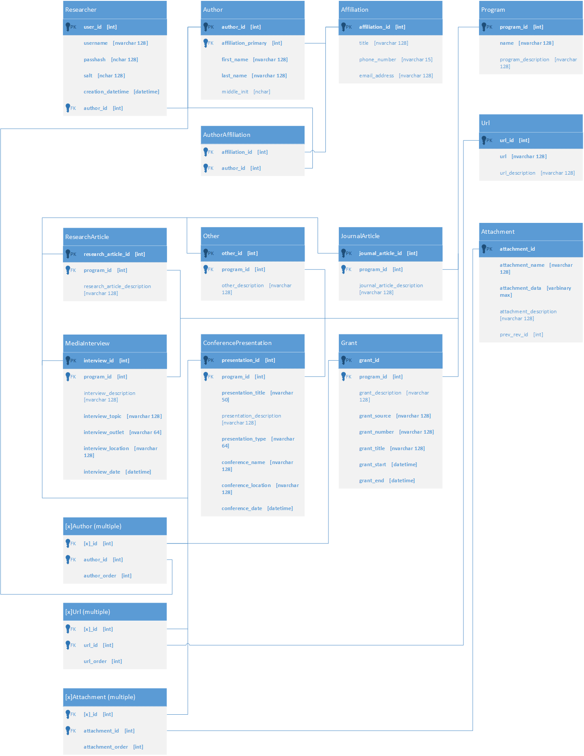
Database
Simplified
Typing Specifications
Researcher
-First Name
-Middle Initial
-Last Name
-Primary Affiliation
-Title
-Phone
-E-mail
-Secondary Affiliation(s)
-Title(s)
-Phone(s)
-E-mail(s)
+Related Products
+Related Grants

Slide 19
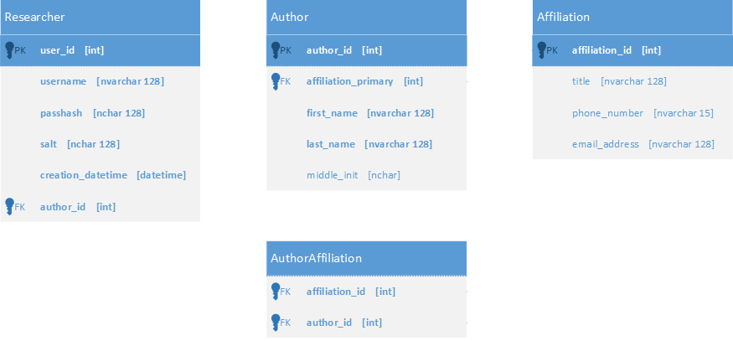
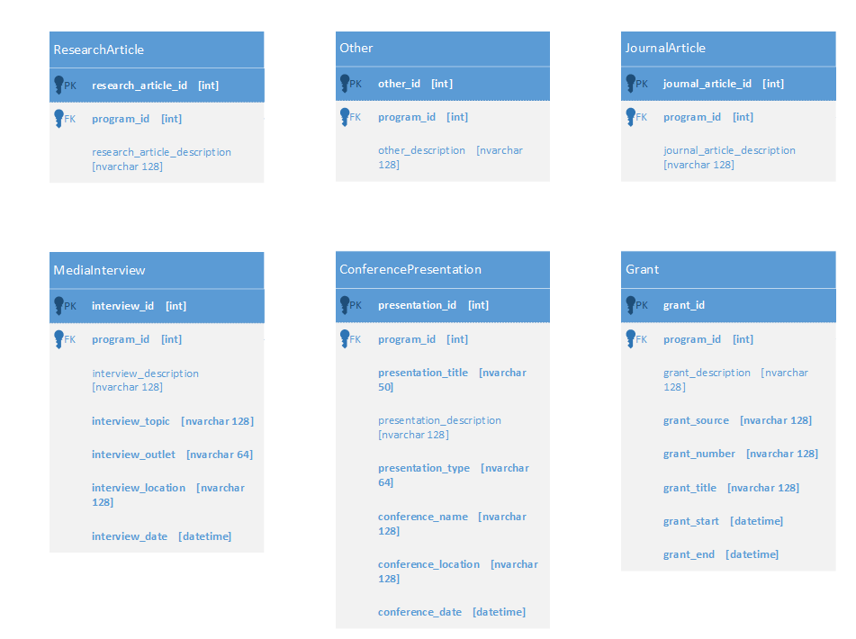
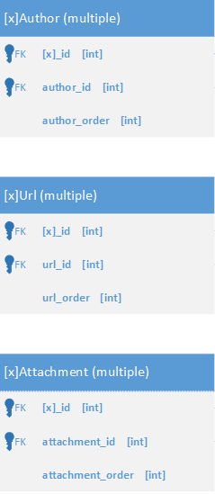
Database

Slide 20
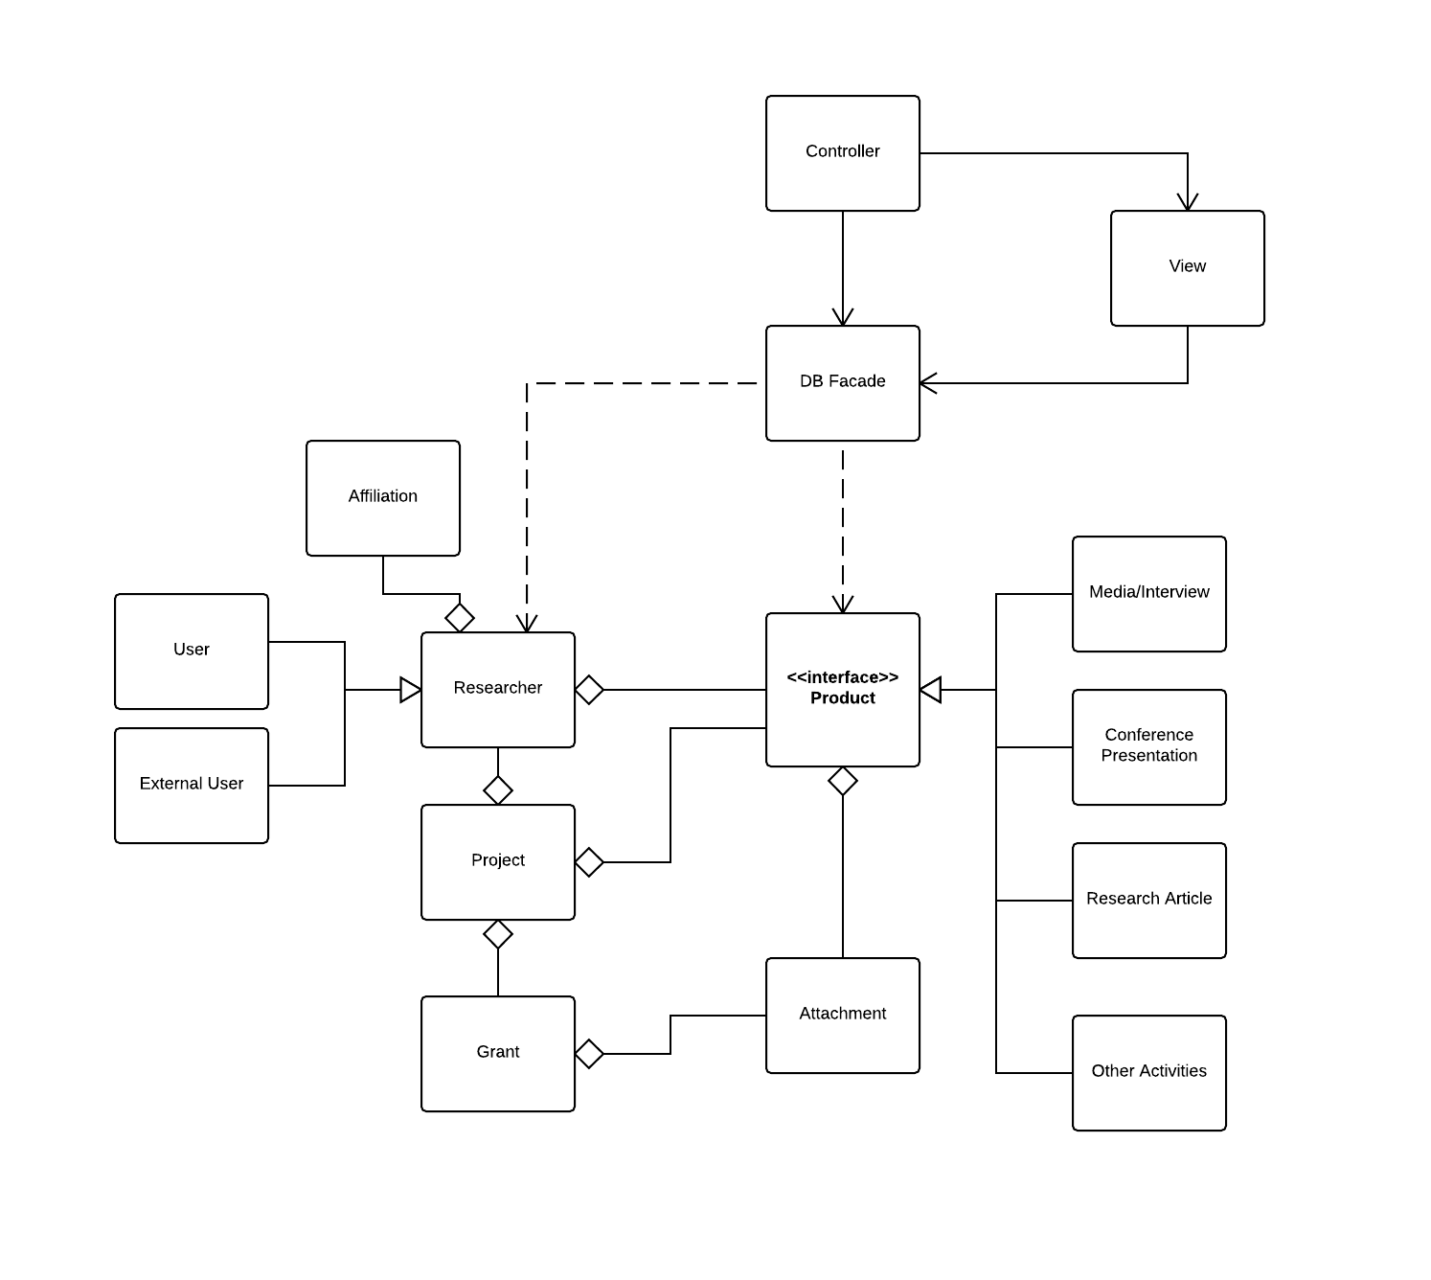
UML

Slide 21
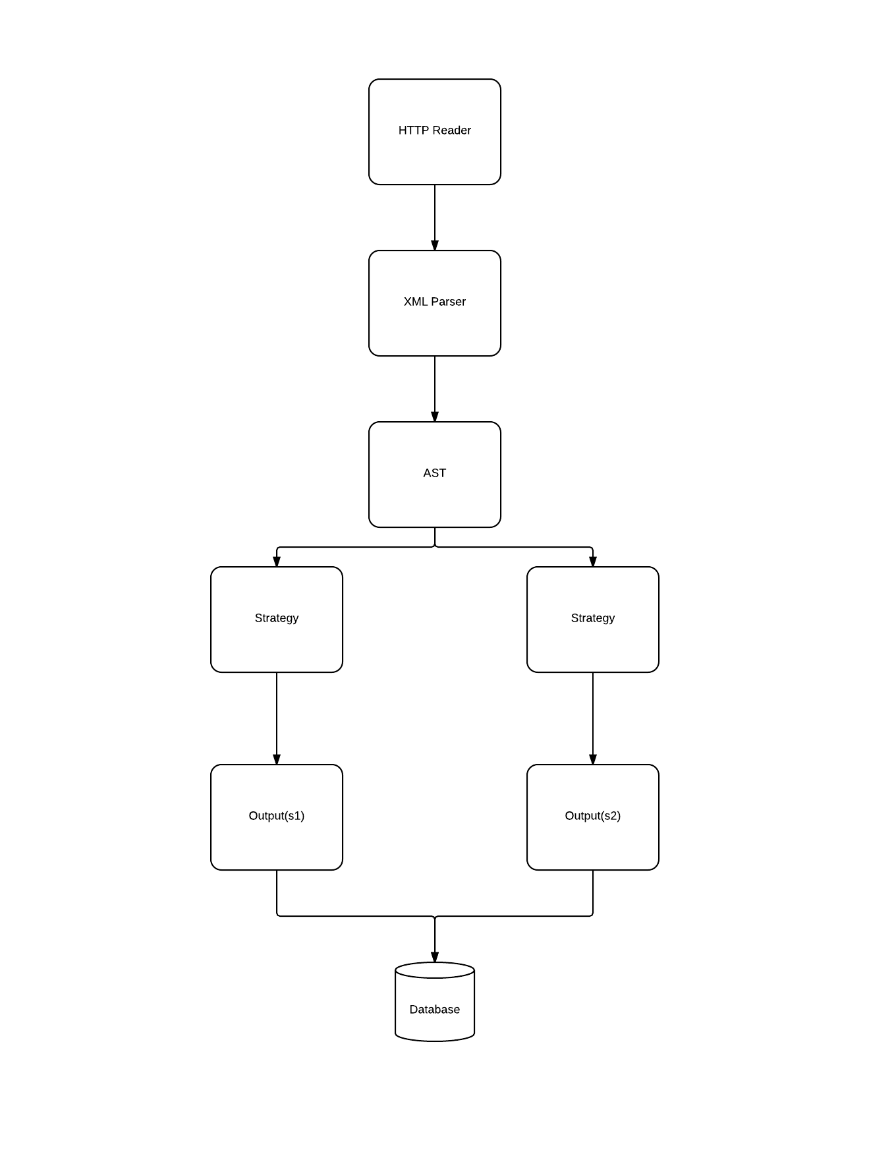
Crawler

Slide 22
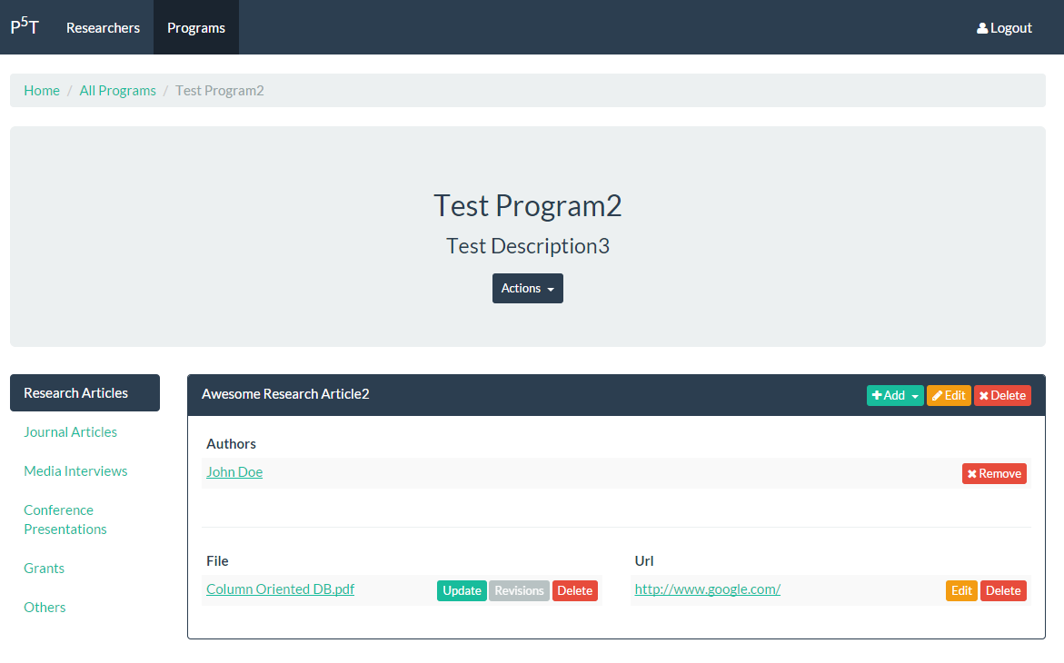
UI Design
Notes:
Don’t talk too much about it. Just state it’s a typical “bootstrap” design. Mention that we would’ve shown a demo, but time constraints are too tight.

Slide 23
Testing & Risks

Slide 24
Risks
Notes:
we should touch upon the fact that we specifically did the web portion early so that we mitigated the risk of not having sufficient time to finish the web portion in case we needed to spend more time on the crawler

Slide 25
Testing
User acceptance testing
UI
Main program features

Slide 26
Current Status
R1 has been delivered to the sponsor.
R2 has been completed and the results have been used to adjust the risk assessment.
R3 is currently in-progress.

Slide 27
Future Plans
Finish web client development.
Design and build web crawler
Finds citations and grants
Notes:
should we mention that we are planning on doing this in parallel with each other?

Slide 28
What Went Well?
Good team communication
Good rapport with sponsor
Completed most of the client requirements in two cycles

Slide 29
What Went Poorly?
Minor schedule slide
Artificial deadlines
Some environment setup problems
Delay with VM setup
MS SQL issues
Metric collection / usage issues.

Slide 30
Questions?

